Slide 1


RE-THREAD INC.
"REDEFINING SUSTAINABILITY, ONE THREAD AT A TIME."

Slide 2
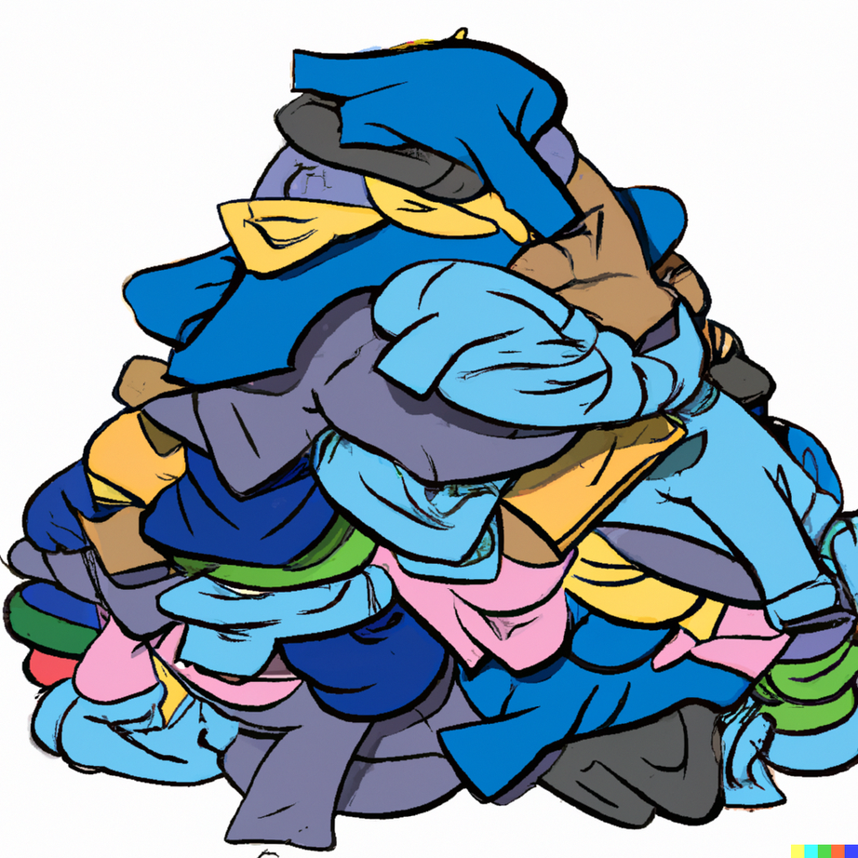


PROBLEM
Lack of good second hand alternatives
Lack of transparency and quality control in existing platforms for buying clothes.
$500B is lost world-wide due to failure to recycle clothes.

Slide 3





SOLUTION: RETHREAD INC
REUSABLE CLOTHING MARKETPLACE
IN-HOUSE QUALITY CONTROL
WAREHOUSING AND REFURBISHING
RENT-A-DRESS OPTION

Slide 4

MARKET VALIDATION
62%
consumers prefer secondhand products over new items
46%
44%
consumers consider resale value of apparel
consumers cut back spending on apparel

Slide 5
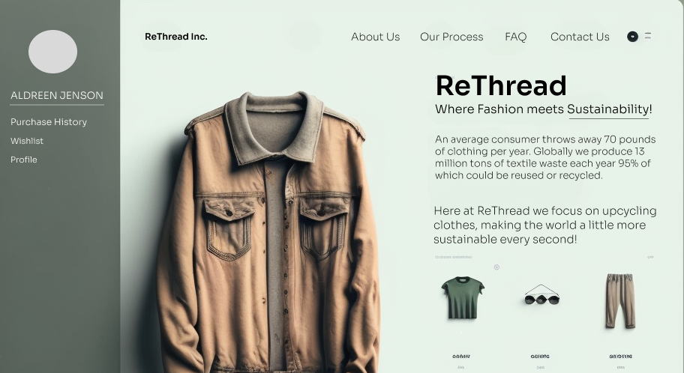
PRODUCT
Quick and Simple process
Branded clothes
Professional UX

Slide 6



BUSINESS MODEL
B2C Business Model
Seller gets money only after the product has been bought
Separate pricing
for recycled
accessories
Reduced pricing
for bulk
or wholesale orders
20% margin after
operations
Rental fee + surcharge

Slide 7









COMPETITION
POSHMARK
VINTED
C2C marketplace
Germany/UK based
THREDUP
Reports of lapse in quality control
KIABZA
THE REALREAL
B2C marketplace based in India
EBAY
not particular for clothes
Reports of non-authentic clothes being sold

Slide 8

COMPETITVE ADVANTAGE
Ensures transparency, and quality of items listed.
We ensure proper quality, cleanliness
Proper verification by agents.
Offers transportation and delivery of goods
by partnering with logistic services
Offers buying of items in bulk
useful for resellers and wholesale buyers
Option to Rent clothes

Slide 9
FUTURE POSSIBILITIES
Release our own line of recycled items fashion brand and have it be sold in existing shops
Partner with NGOs and charity organizations and have clothes which are not sold be donated
Try recycling dead-stock to new items which can be sold separately

Slide 10
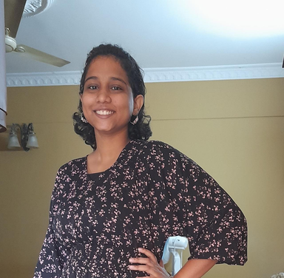
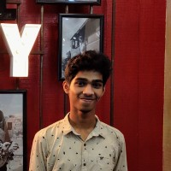
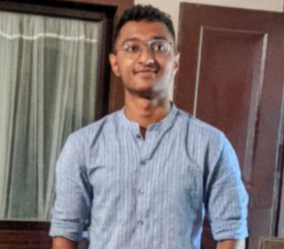
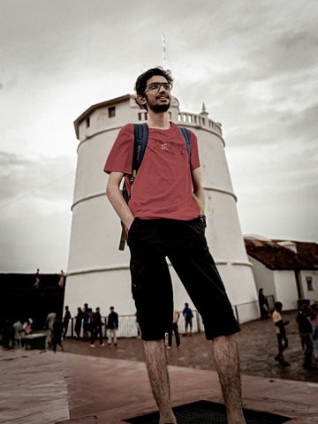

TEAM
RESHMA J NAIR
CHIEF FINANCIAL OFFICER
ALDRIN JENSON
ARUN SOJAN PAROLIKKAL
CHIEF EXECUTIVE OFFICER
CHIEF TECHNOLOGY OFFICER
GOKULNATH M PRABHU
DEVANARAYAN J
CHIEF OPERATIONS OFFICER
CHIEF DESIGN OFFICER

Slide 11
QUESTIONS?
Re-Thread Inc.

